Slide 1
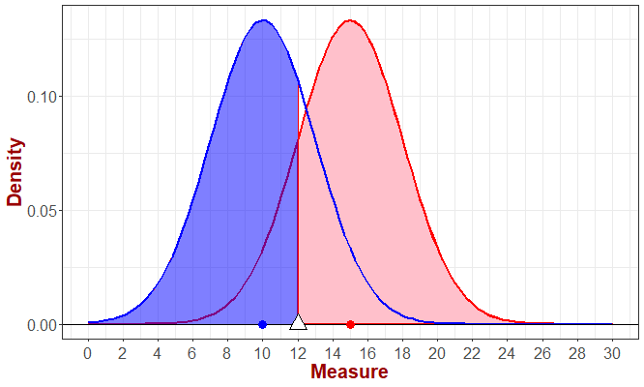
Elements of a diagnostic test based on the
population distribution of a biomarker
Healthy
Disease
P(-|H)
P(+|D)
Biomarker (for instance a concentration, activity, fluorescence, etc.)
(-) : If the biomarker has a value lower that the critical value for defining the diagnostic
(+) : If the biomarker has a value higher that the critical value for defining the diagnostic

Slide 2

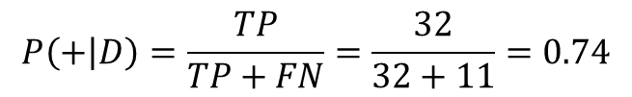
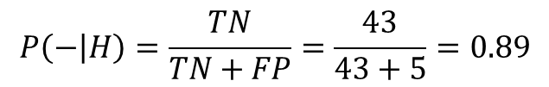
Basic concepts in a clinical test
Sensibility: Probability of a positive result among people having a disease, P(+|D)
Specificity: Probability of a negative result among healthy people, P(-|H)
Estimation of sensibility and
specificity from data
Disease
Healthy
Disease
Healthy
(+)
32
5
(+)
TP
FP
(-)
11
43
(-)
FN
TN
$$P\left(+ | D\right)=\frac{TP}{TP+FN}=\frac{32}{32+11}=0.74$$
$$P\left(− | H\right)=\frac{TN}{TN+FP}=\frac{43}{43+5}=0.89$$

Slide 3


Predictive values
Positive predictive value (PPV): P(D|+) is the probability that a subject has the disease if the test result is positive.
Negative predictive value (PPV): P(H|-) is the probability that a subject is healthy if the test result is negative.
$$P\left(D | +\right)=PPV=\frac{P(+|D)×P(D)}{P\left(+ | D\right)×P\left(D\right)+P(+|H)×P(H)}$$
$$P\left(H | −\right)=PPV=\frac{P(−|H)×P(H)}{P\left(− | H\right)×P\left(H\right)+P(−|D)×P(D)}$$
The predictive value of a test depend on its sensibility and specificity and on the prevalence (P(D)) of the disease in the population in which by are applying the test. When we design test, we can work on having good sensitivity and specificity, BUT the prevalence is a question of the actual population!

Slide 4
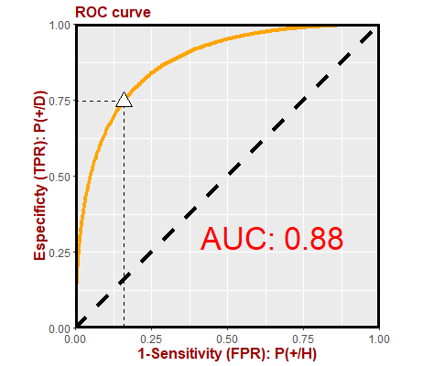
ROC Curve
The ROC curve evaluates the discriminant ability of this biomarker in a given scenario. The AUC measures the performance in each case. An AUC=0.5 indicates that the chosen biomarker performs as tossing a money. The optimal discrimination is attained for high values of AUC (closed to 1).

